Slide 1
IS4432 Systems Design
Week 2 Interaction Diagrams
Prepared by Janet Yu
115/11/07
IS4432

Slide 2
Agenda
Behavioral Models
Interaction Diagrams
  Sequence Diagrams
  Communication Diagrams
Behavioral State Machines
CRUD Analysis
115/11/07
IS4432

Slide 3
Behavioral Models
115/11/07
IS4432

Slide 4
3 Models of an Information System
Functional Models
  Describe the external behavioral view
Structural Models
  Depict the static view
Behavioral Models
  Represent the internal behavior or dynamic view
115/11/07
IS4432

Slide 5
2 Types of Behavioral Models
Interaction Diagrams (Sequence & Communication)
  Represent the underlying details of a business process portrayed by a use-case model
State Machine
  Represent the changes that occur in the underlying data
115/11/07
IS4432

Slide 6
Behavior Models
Used traditionally during design
During its creation, often has to make changes to the functional and structural models
115/11/07
IS4432

Slide 7
Interaction Diagrams
Focus on the object level
  Object is an instantiation of a class
  Each object has behaviors
  Behaviors are described by operations → an action that an object can perform
  Messages are information sent to objects → a function or procedure call
115/11/07
IS4432

Slide 8
Kinds of Messages
In UML, you can model five basic kinds of messages:
Call | Invokes an operation on an object.
Return | Returns a value to the caller.
Send | Sends a signal to an object.
Create | Creates an object.
Destroy | Destroys an object.
115/11/07
IS4432

Slide 9
Sequence Diagram
115/11/07
IS4432

Slide 10
Sequence Diagrams
Illustrate the objects that participate in a use case and the messages that pass between them over time
Helpful for understanding real-time specifications and complex use cases
Can be a
  Generic sequence diagram
    Shows all possible scenarios for a use case
  Instance sequence diagram
    Depicts a single scenario within the use case
115/11/07
IS4432

Slide 11
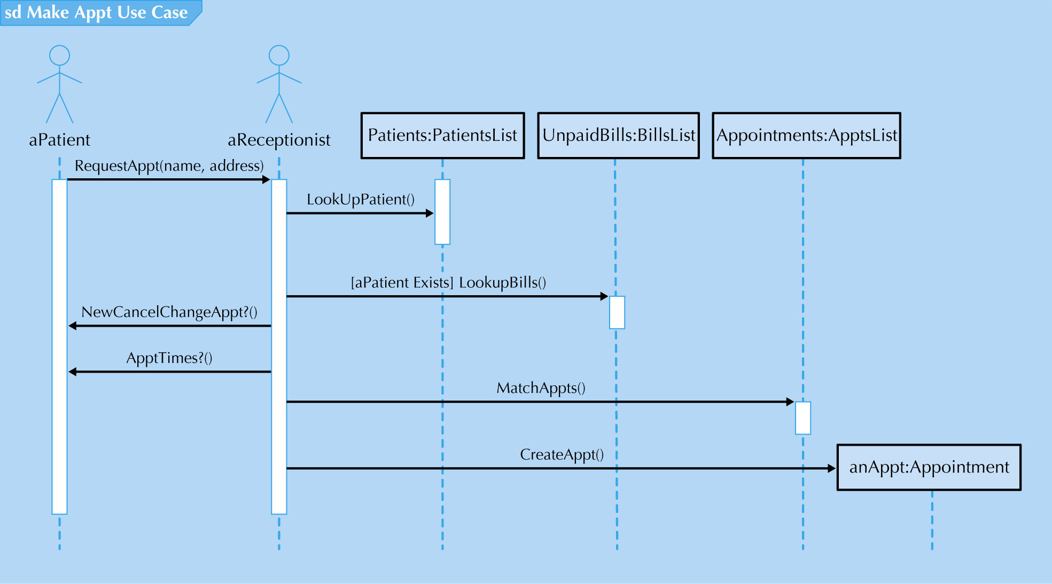
Sample Sequence Diagram
115/11/07
IS4432

Slide 12
Elements of a Sequence Diagram
Actors and objects
  Can be temporary objects
Lifeline
Execution occurrence
  Overlaid onto the lifeline
Message
  Call message or return message
  * for repeated message
Guard condition
Frame
  Indicates the context
115/11/07
IS4432

Slide 13
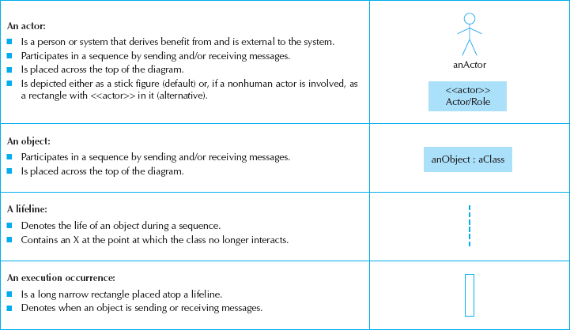
Sequence Diagram Syntax (1)
115/11/07
IS4432

Slide 14
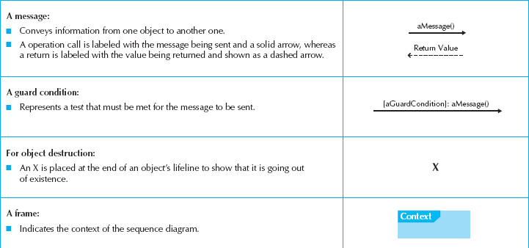
Sequence Diagram Syntax (2)
115/11/07
IS4432

Slide 15
Sequence Numbers
Sequence numbers can be added in to allow easier reference.
You can prefix the message with a number increasing monotonically for each new message in the flow of control (e.g. 1, 2, 3).
To show nesting, use Dewey decimal numbering (e.g. 1, 1.1, 1.1.1).
115/11/07
IS4432

Slide 16
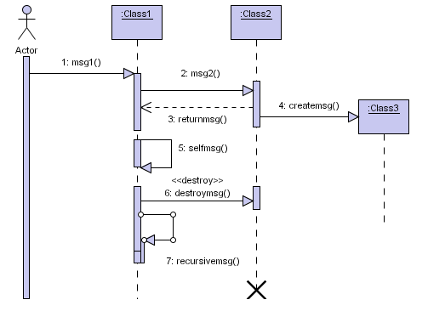
Message Example
115/11/07
IS4432

Slide 17
Condition & Iteration
For branching, can attach a Boolean condition such as [i > 1] in front of the message. The message is sent only if the condition is true.
For repetitive execution, can attach an iteration notation such as *[i:=1..n] or *[for all order lines] in front of the message.
UML does not prescribe the format of the expression inside the brackets.
115/11/07
IS4432

Slide 18
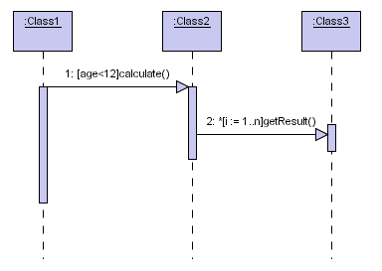
Condition & Iteration Example
115/11/07
IS4432

Slide 19
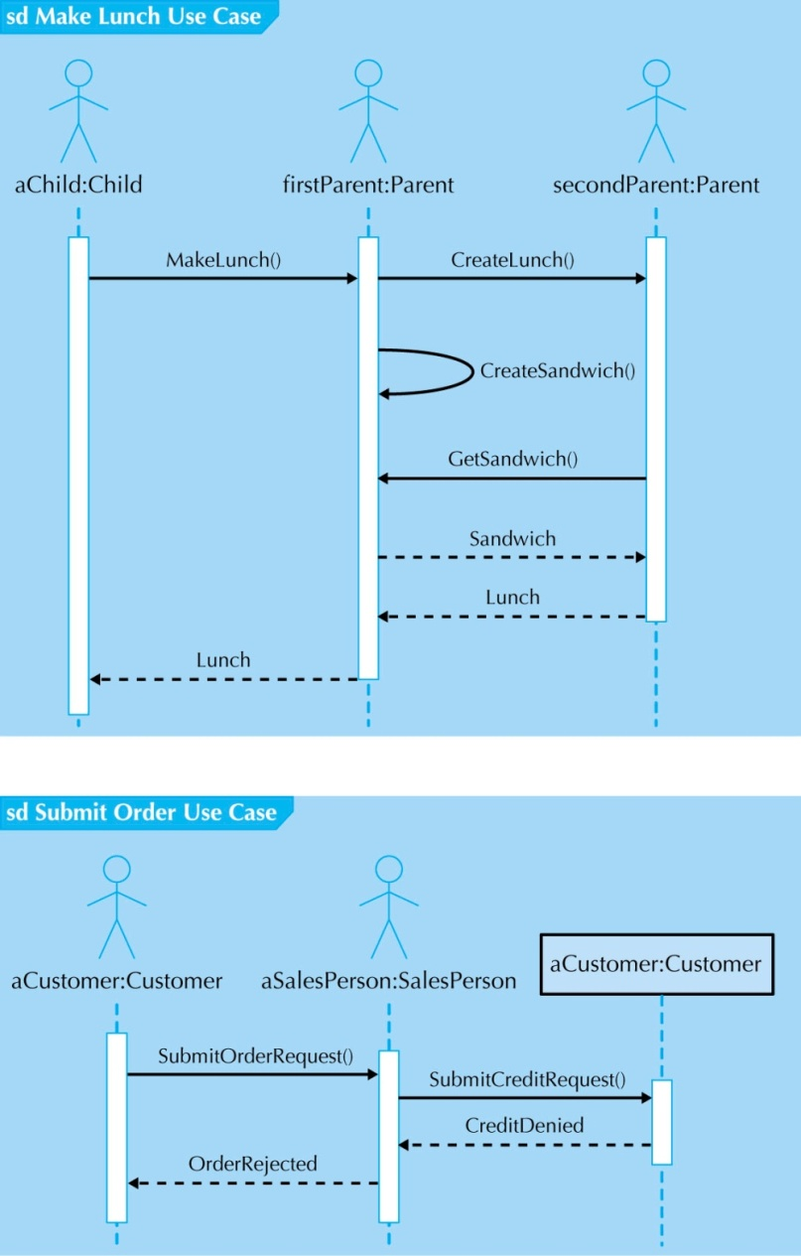
More
Sequence
Diagrams
115/11/07
IS4432

Slide 20
Steps for Building Sequence Diagrams
Set the context
Identify which objects will participate
Set the lifeline for each object
Lay out the messages from the top to the bottom of the diagram based on the order in which they are sent
Add the execution occurrence to each object’s lifeline
Validate the sequence diagram
115/11/07
IS4432

Slide 21
Communication Diagram
115/11/07
IS4432

Slide 22
Communication Diagrams
Can portray how dependent the different objects are on one another
Is an object diagram that shows message-passing
Useful to show process patterns
Equivalent to sequence diagrams but emphasize the flow of messages through a set of objects
115/11/07
IS4432

Slide 23
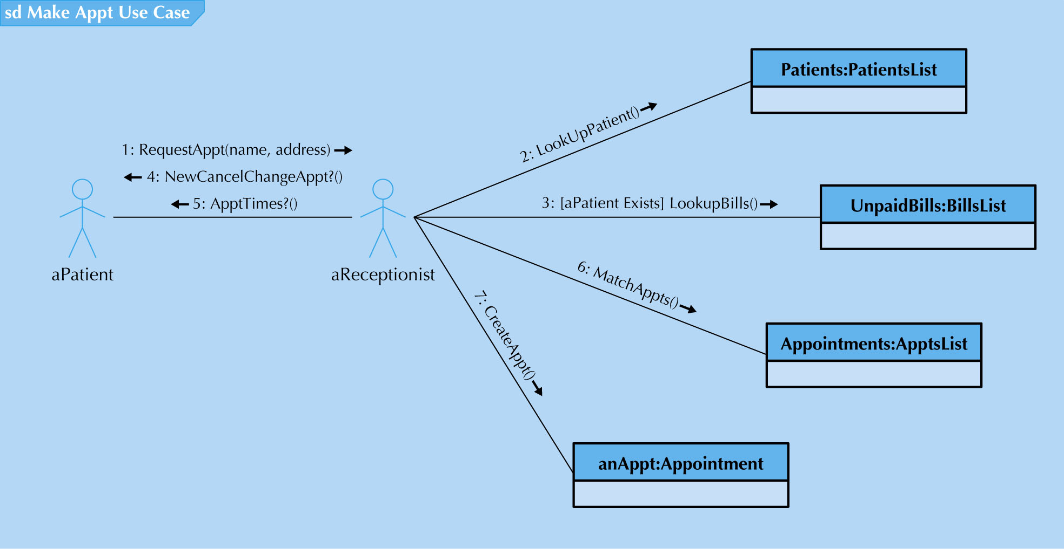
Sample Communication Diagram
115/11/07
IS4432

Slide 24
Steps for Building Communication Diagrams
Set the context
Identify which objects (actors) and the associations between the objects participate in the collaboration
Lay out the communication diagram
Add messages
Validate the communicate diagram
115/11/07
IS4432

Slide 25
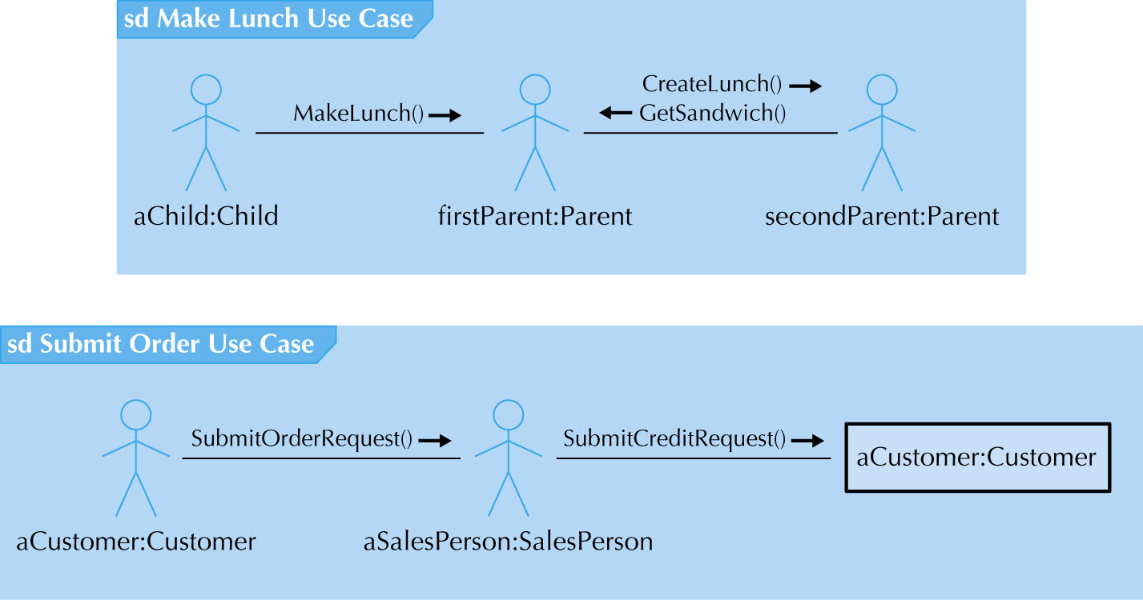
More Communication Diagrams
115/11/07
IS4432

Slide 26
Behavioral State Machine
115/11/07
IS4432

Slide 27
Behavioral State Machines
Shows the different states through which a single object passes during its life in response to events, along with its responses and actions
Dynamic view of a single class
115/11/07
IS4432

Slide 28
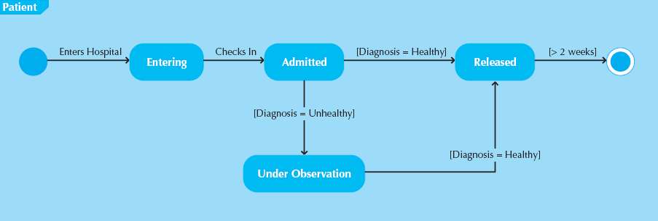
Sample State Machine
115/11/07
IS4432

Slide 29
Elements of a State Machine (1)
State of an object
  Defined by the value of its attributes
  Initial state & final state
Event
  Something that takes place at a certain point in time and changes a value or values that describe an object
Transition
  A relationship that represents the movement of an object from one state to another
Guard condition
  a boolean expression that includes attribute values, which allows a transition to occur only if the condition is true
115/11/07
IS4432

Slide 30
Elements of a State Machine (2)
Action
  Atomic, non-decomposable process
  Associated with a transition
Activity
  Nonatomic, decomposable process that can be interrupted
  Associated with states
115/11/07
IS4432

Slide 31
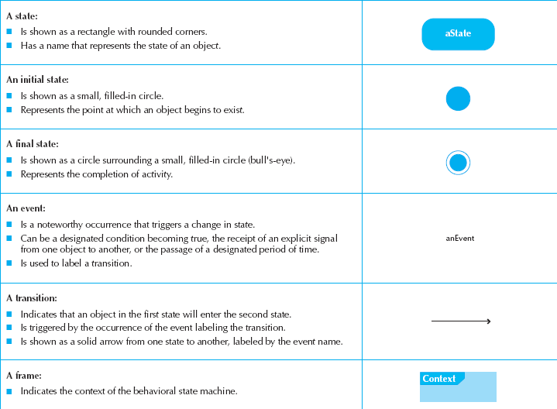
State Machine Syntax
115/11/07
IS4432

Slide 32
Steps for Building a State Machine
Set the context
Identify the initial, final, and stable states of the object
Determine the order in which the object will pass through the stable states
Identify the events, actions, and guard conditions associated with the transition
Validate the behavioral state machine
115/11/07
IS4432

Slide 33
CRUD Analysis
CRUD stands for create, read, update and delete
A CRUD matrix is adapted to OO systems development
It is most useful as a systemwide representation
More interactions among a set of classes mean they should be clustered together in a collaboration
Can help to identify complex objects for state modeling
115/11/07
IS4432

Slide 34
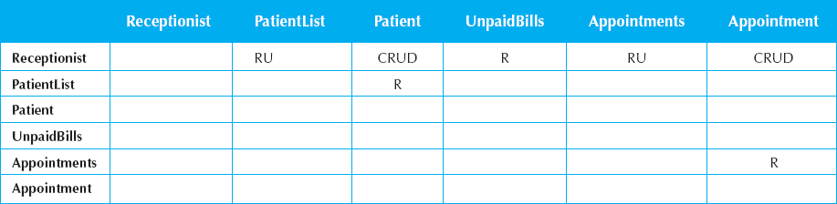
Sample CRUD Matrix
115/11/07
IS4432

